Slide 1
SEC530
Defensible Security Architecture and Engineering
Have You Taken The “Endpoint Blue Pill”? Debunking The Endpoint Protection Myth
Ismael Valenzuela (GSE # 132) and Justin Henderson (GSE # 108)
@aboutsecurity @SecurityMapper
Notes:
Overview
"My endpoint is protected, I have a current AV & I'm fully patched"
"I know bypassing AV is possible, but it's hard!"
"I'm using application whitelisting, I'm good!"
"oh, that's APT-like stuff only, we don't have any of that here..."
If you've heard yourself saying (or thinking) any of the above, you may still live in tranquil happiness. But let me tell you: those are just the effects of taking the 'endpoint blue pill'. One that makes you believe in a world where endpoint protection works, where spending most of your time in hardening, patching and auditing cycles, gives you a sense of satisfaction and a job well done, and where there's no single evidence of any of the advanced attackers that the media reports on in your network.
Do you want to learn the truth?
Join Ismael Valenzuela and Justin Henderson, GSEs, instructors and co-authors of one of the most popular SANS Blue Team classes, SEC530: Defensible Security Architecture & Engineering, as they debunk this and many other myths around endpoint security through live demos, and learn how to architect and engineer layered defenses, not only for endpoint prevention, but also for visibility, detection and response, that work across hybrid environments.
"Remember: all I'm offering is the truth. Nothing more."

Slide 2


About Us
Ismael Valenzuela
SEC530 Co-author / SEC503 and SEC511 Instructor
GSE # 132 and also a certification master
Sr. Principal Engineer at McAfee
Twitter: @aboutsecurity
Justin Henderson
SEC555 Author / SEC455 and SEC530 Co-Author
GSE #108 / Cyber Guardian Blue + Red / 60 certs
Owner of H & A Security Solutions
Twitter: @SecurityMapper

Slide 3
Signs You May have an Endpoint Blue Pill Overdose
We love all things ‘Blue’ but too often we find organizations that exhibit signs of having a Blue Pill overdose, specially on Endpoint Security:
My system is fully patched
I have the latest & greatest AV signatures
I have application whitelisting and HIPS!
And my data is encrypted! Therefore, I am secure!
And some of my favorites…
Why would you detect, when you can prevent!? If you can detect you can block it!
My <insert next-gen, blockchain, ML, AI, magic unicorn pixie dust here> has a ‘signature’ for that. I can block it!
Notes:
Blue pill – remain in blissful ignorance of illusion
Red pill – embrace the sometimes painful truth of reality
This can be extrapolated to network protection too: fws, proxies, IPS, but today we’ll focus on endpoint as its getting the most attention.

Slide 4
What if…
… it wasn’t that difficult to bypass default protection mechanisms on the endpoint?
Let’s demo it!
Notes:
Some folks may say: yeah but that AV bypass stuff is very APT.
DEMO of Defender AV Bypass using DNSCAT
DNSCAT download – defender blocks
Download source and compile – no block!

Slide 5
Let’s Bring All Into Context
A defensible security architecture requires prevention + detection + response.
When architecting or engineering security solutions, you never have unlimited budget. So where do you put your money?
Notes:
Are you saying we don’t need AV anymore??
Let’s bring all this into context – a defensible security architecture requires prevention + detection + response. These all play a relevant role.

Slide 6
Time-Based Security – Blog Post at http://aboutsecurity.io/TBS
Reproducible method to understand how much ‘security’ a product or technology provides
How long are systems exposed?
How long before we detect a compromise?
How long before we respond?
P – how long our protection works
D – how long it takes us to detect
R – how long it takes us to react
P > D + R
Notes:
Whiteboarding here --- see OD video.
TERRIBLY SIMPLE MODEL… WRITTEN IN 99. FREE BOOK.
BUT USEFUL TO ASSESS WHETHER A SECURITY TECHNOLOGY MAKES SENSE AND HOW IT FITS INTO YOUR SECURITY ARCHITECTURE.
While it is usually applied to auditing, TBS is a very practical model to assess and design security architectures too. The method proposed is very simple, but it provides you with the knowledge and the tools required to make systems more secure and resilient.
"We've been looking at security the wrong way [...] Fortress Mentality insists that building tall electronic walls is how to keep the bad guys out. That method hasn't worked for 5000 years of warfare, so why should it work for computer security? It can't and it doesn't." -- Winn Schwartau.
LET ME ASK YOU? WHEN ARCHITECTING A SYSTEM? WHAT IS MOST IMPORTANT? PREVENTION OR DETECTION?
Here's the main idea:
"If it takes longer to detect and to respond to an intrusion than the amount of protection time afforded by the security measures, that is if P < D + R then effective security is impossible to achieve in this system. It should be becoming a little bit obvious that the choice of a good protection system is not the first thing you need to think about when designing a secure network environment. It’s the efficacy of the detection and reaction processes that really matters."
EXAMPLES – BREAKING INTO VAULT
WATCHMAN – SOMEONE IS COMING WITH CATAPULTS… 1 DAY TRAVEL DISTANCE… THAT’S YOUR REACTION TIME! THREAT INTEL HELPS YOU SHORTED D+R.
IDEALLY D+R should be equal to ZERO. But REACTION many times involves HUMAN intervention.
THE FASTER THE D+R, the less I care about protection… less high walls.
RANDY MARCHANY – VIRGINIA TECH – DBAs filling up Databases with ZEROS…
PREVENTION RUNS PARALLEL TO DETECTION & RESPONSE.
DRAW. SO WHAT DETERMINES IF A SYSTEM IS SECURE… IS IT THE PROTECTION??
It’s the efficacy of the detection and reaction processes that really matters.”
THIS CAN BE BROKEN DOWN PER PHASE OF THE ATTACK FOLLOWING…
---
Time-Based Security
Usually applied to auditing, time based security can be a very practical model to assess and design security architectures too.
"We've been looking at security the wrong way," says 'security maven Winn Schwartau. "Fortress Mentality insists that building tall electronic walls is how to keep the bad guys out. That method hasn't worked for 5000 years of warfare, so why should it work for computer security? It can't and it doesn't." Written in Schwartau's highly popular and entertaining style, Time Based Security is a not - too - technical paradigm shift which gives you new tools to handle network security completely differently: - A simple method to measure your security efforts more efficiently, - A framework so management can make informed decisions as to where to smartly invest their security budget dollars. Within minutes, you will be able to judge how secure or insecure your network is! Time Based Security provides you with the tools you need to make your systems more secure than ever before. "Required reading for infosecurity professionals! Practical advice regarding fundamental security needs-- protection, detection, and reaction." Peter Harrison, Director of Marketing, MEMCO Software.
[1] https://www.amazon.com/Time-Based-Security-Winn-Schwartau/dp/0962870048

Slide 7
Endpoint Protection Platform <-> Endpoint Detection & Response
Known
Unknown but built on known behavior
New / Unknown
Complex
APT
Where Prevention works
Where Detection Picks Up
EPP
EDR
Notes:
Are these technologies converging? Absolutely!

Slide 8
Advanced EPP capabilities: HIPS / Expert Rules
Some EPP solutions have extended their capabilities to provide further protection to ”unknown but built on known behavior” attacks.
Example: McAfee ENS Expert Rules are Host based IPS text-based rules that users can customize to describe block & alert on certain behaviors.
McAfee proprietary syntax based off from Tcl v7.6, supporting the following class types:
Files – these rules specify Files protection.
Process – these rules specify Process protection.
Registry – these rules specify Registry Value and Key protection.
Notes:
Require the understanding of the McAfee proprietary syntax.
Expert rules functionality was originally implemented in HIPS and then ported into ENS where besides exposing HIPS type of rules, a new subset was added engine with the purpose of exposing the AAC Engine

Slide 9
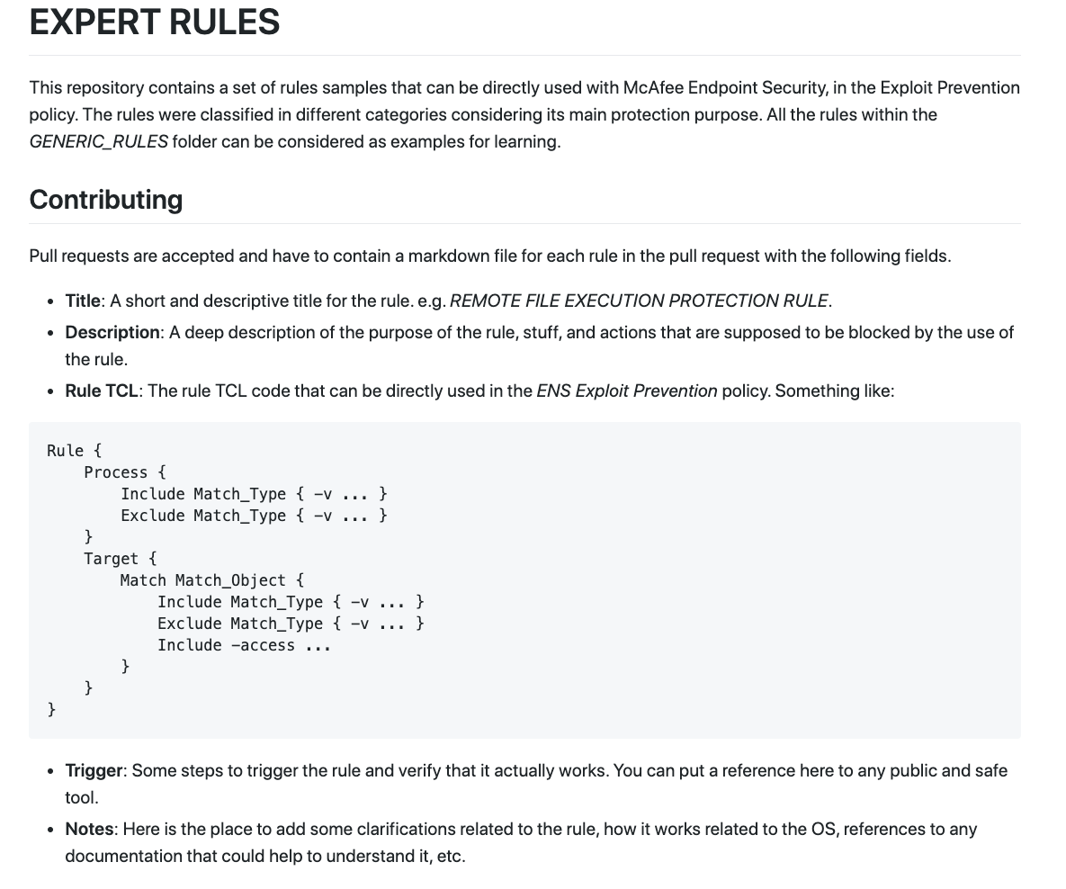
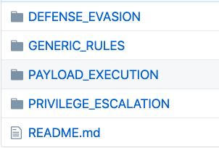
Example of Advanced EPP capabilities: HIPS / Expert Rules
https://github.com/mcafee/ExpertRules

Slide 10





Example of Advanced EPP capabilities: HIPS / Expert Rules
Prevent Document Interpreter Extern Command Execution Rule
Prevent Credential Dumping From LSASS Rule
EXE
Scripts
Executables (like Mimikatz)
User receives document as email attachment in targeted attack
User opens the document and it has a macro embedded that launches PowerShell
PowerShell download & execute payload in memory only
Download & in-memory execution & reflectively load code. Payload can perform exfiltration, damage etc.
Dropper
Payload
Notes:
Expert Rules is a good feature to ensure “early protection” on the endpoints against new threats in the field.

Slide 11
Attack to dump credentials – Rule approach 1
Rule {
Process {
Include OBJECT_NAME { -v outlook.exe }
}
Target {
Match PROCESS {
Include OBJECT_NAME { -v winword.exe }
Include -access "CREATE"
}
Next_Process_Behavior {
Target {
Match PROCESS {
Include OBJECT_NAME { -v powershell.exe }
Include PROCESS_CMD_LINE {
-v "*-NoLogo*" -v "*-c *" -v "*-nop*" -v "*-exec*" -v "*-ep*“
-v "*iex*" -v "*-File*" -v "*-EncodedCommand*" -v "*-enc*" -v "*-Command*"
}
Include -access "CREATE"
}
}
}
}
}
The rule will fire when hitting the last chain link, in this case, when PowerShell is created.
Notes:
Expert Rules is a good feature to ensure “early protection” on the endpoints against new threats in the field.
Rule initiator
Composed by the objects that incur into the action
Process and Thread objects that can be consider as initiators
The matching criteria for these initiators can be funnel down to match specific set of conditions defined through the match sections added to initiator scope
Rule target
Composed by all the Matching Section objects defined on the rule
Currently the following Matching Section objects are supported by the AAC filtering engine: FILE, KEY, VALUE, PROCESS, THREAD, SECTION, DISK, NAMEDSECTION
The match criteria for each Section Object can be also funnel down to match specific conditions
Match Object
Is a collection of matching criteria (also referred to as match types), which describe a monitored system object. That said a match object can have criteria that belong only to one of the system object types.
A Match Criteria or Match Type is essentially the information we are looking for match.
The PROCESS CMD LINE are all OR, that do an AND with what’s inside the OBJECT_NAME. Therefore POWERSHELL AND any of those modifiers.
You can BLOCK or put it into monitoring mode.
Starting on ENS 10.7 we can also monitor the actual data being assigned to a registry value, privilege escalation, processes trying to load a DLL, etc... In this case, we monitor the assignment to the random value.

Slide 12
Common Applications Running at High Integrity?
Starting with Vista, Windows use Integrity Levels (IL) based isolation to running processes. The IL represents the level of trustworthiness of an object.
Goal is to selectively restrict the access permissions in contexts that are considered to be less trustworthy.
i.e. why would calc, notepad or mspaint run with HIGH integrity?
Windows Vista defines four integrity levels:
Low (SID: S-1-16-4096)
Medium (SID: S-1-16-8192)
High (SID: S-1-16-12288)
System (SID: S-1-16-16384)
By default, processes started by a regular user gain a Medium IL and elevated processes have High IL.
Notes:
By introducing integrity levels, MIC allows classes of applications to be isolated, enabling scenarios like sandboxing potentially-vulnerable applications (such as Internet-facing applications). Processes with Low IL are called low-integrity processes, which have less access than processes with higher ILs where the Access control enforcement is in Windows.
Windows makes sure that a process can write to or delete an object only when its integrity level is equal to or higher than the requested integrity level specified by the object.^{[2]} Additionally, for privacy reasons process objects with higher IL are out-of-bounds for even read access from processes with lower IL.^{[3]}
Consequently, a process cannot interact with another process that has a higher IL. So a process cannot perform functions such as inject a DLL into a higher IL process by using the CreateRemoteThread()^{[4]} API function or send data to a different process by using the WriteProcessMemory()^{[5]} function.

Slide 13
Expert Rule Example: Common Applications Running at High Integrity?
Rule {
Process {
Include OBJECT_NAME { -v "*.exe" }
}
Target {
Match PROCESS {
Include OBJECT_NAME {
-v "calc.exe"
-v "notepad.exe"
}
Include GROUP_SID { -v "S-1-16-12288" }
Include -access "CREATE"
}
}
}
This kind of applications are not supposed to be running at high integrity level, and they are every time a good target for the attackers.

Slide 14
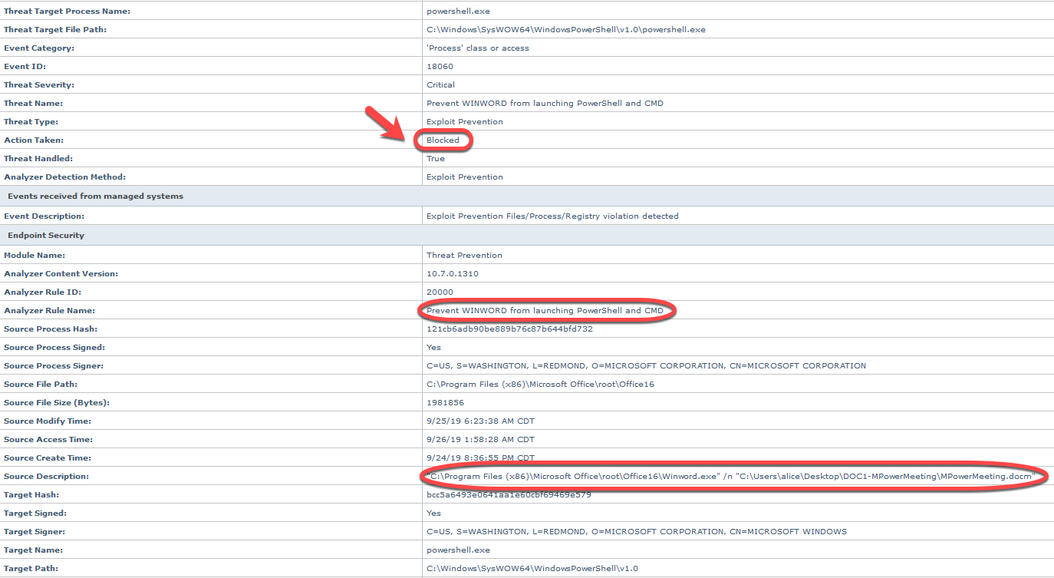
Remember, a Blocked Event is NEVER Block & Forget

Slide 15
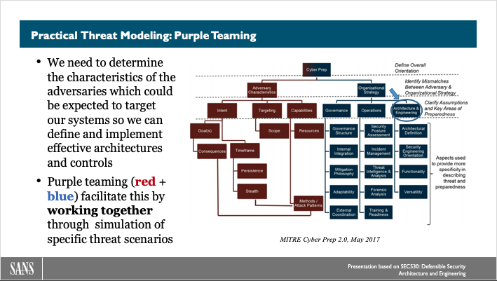
How Do You Architect for Prevention + Detection + Response
In past webinars we’ve talked about benefits of purple teaming as practical threat modeling:
https://www.sans.org/webcasts/defensible-security-architecture-engineering-2-thinking-red-acting-blue-mindset-actions-109710
Quoting Schwartau, since “it’s the efficacy of the detection and reaction processes that really matters”, what references can we use to architect & engineer endpoint security, with a focus on Detection and Response capabilities?

Slide 16
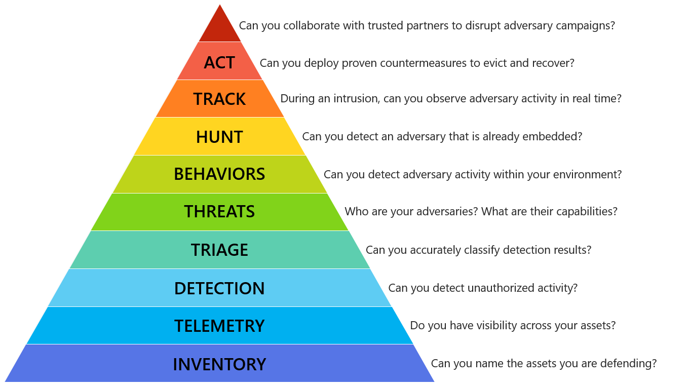
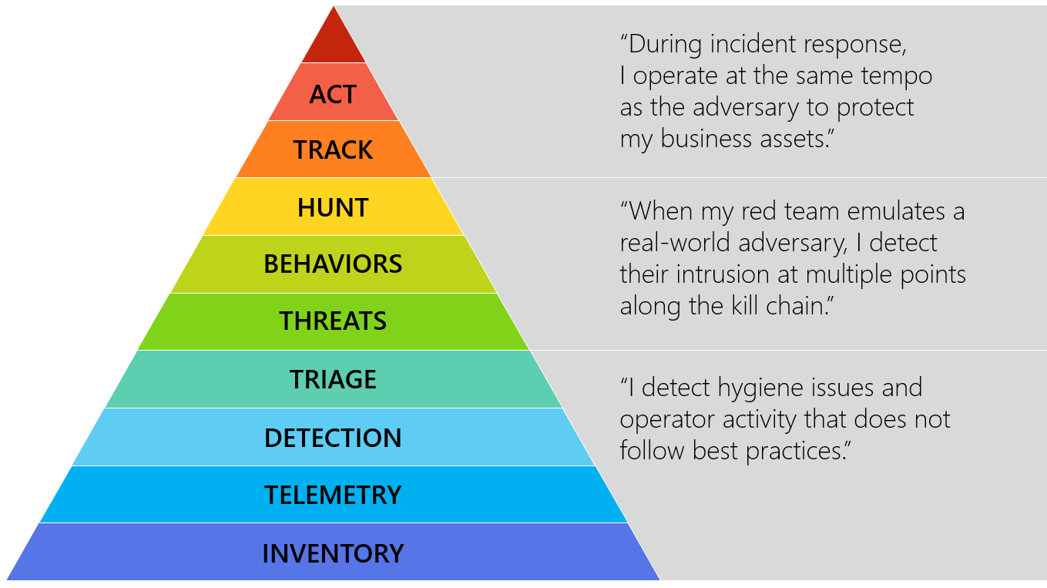
The Incident Response Hierarchy of Needs by Matt Swann
https://github.com/swannman/ircapabilities
Notes:
The Incident Response Hierarchy is modeled after Maslow's Hierarchy of Needs. It describes the capabilities that organizations must build to defend their business assets. Bottom capabilities are prerequisites for successful execution of the capabilities above them.
<WALK THROUGH THE PYRAMID>
We’re going to walk through some strategies and solutions you can use to achieve these outcomes, starting with inventory and telemetry.

Slide 17
Endpoint Security Needs: Inventory & Telemetry
You can’t protect what you don’t know you have or what you can’t see.
There’s a wealth of solutions that can provide you increased visibility across your endpoints, i.e.
Sysmon,
Osquery,
EDR-like solutions can provide a ton of raw telemetry as well
Notes:
Idea of ADAPTIVE telemetry.
From DEFCON 5 to DEFCON 1.
The problem right now is not too much about LOGGING ALL (we didn’t have that before) but what do you do with ALL that data. Security is turning more into a BIG DATA problem.

Slide 18

Questions & Answers: osquery
Open-source endpoint
Originally developed at Facebook
Ask Questions and Get Answers!
Turns system calls into virtual SQL tables
(Structured Query Language)
Universal Endpoint
Cross-platform
Cross-virtualization (level)
Cross-maturity
Notes:
So, why is osquery important?
osquery is an open-source endpoint package, originally developed at Facebook, and released as open-source in 2014.
The simple question of "what is osquery" is that it is a way to ask questions and get answers of an incredibly wide variety of hosts in most IT environments
The core concept of osquery is that it abstracts information that you would normally get from running system utilities into virtual SQL tables. Most people have heard of SQL, but if it is new to you, it stands for "Structured Query Language," is a reference to how you interact with a large majority of databases that power the internet and applications today.
Some people refer to osquery as the "Universal Endpoint" because it runs on a wide variety of operating systems, including most flavors of Linux, macOS, and Windows. However, I feel that it is more than that – osquery also runs at what we call "cross virtualization levels" – it will run on a real server, a virtual machine, in a container, or in a cloud instance. This allows it more flexibility than a lot of solutions that are built specifically for cloud or containers. And a lot of organizations exist at more than one level of virtualization at a time – osquery allows you to have one solution that applies to both VMs and containers, real servers as well as cloud.
Also, osquery is cross maturity level – what do we mean by that? A lot of organizations change technology and how they use it as the evolve or mature. They will also have different needs out of their security program and products.
A deployment of osquery at scale can provide value for organizations that are just starting out, but at the same time, provide different capabilities and value to organizations that are established and mature. Thus osquery can grow with an organization, preventing you from having to buy tons of new security solutions as time goes on.

Slide 19
osquery: Abstract the Operating Systems to SQL
ps -ef | grep apached
or
ps -C apached
or
ps ax | grep apache
Standardizing on SQL
Select * from processes where name like ‘%apache%’
With osquery, SQL tables represent the current state of operating system attributes, such as:
running processes
loaded kernel modules
open network connections
SQL tables are implemented via an easily extendable API. Several tables already exist and more are being written.
Notes:
most system commands on an operating system have varied formats, and a wide variety of arcane command switches and references that need to be memorized – and these are not remotely consistent across different operating systems
Here you see several different ways of using the "ps" command on linux to see if an Apache webserver is running. Some of these might not work on other operating systems, or require different command formats.
But the bottom command, standardized in SQL, would be able to tell you if apache is running on a mac, linux, or windows . . .

Slide 20
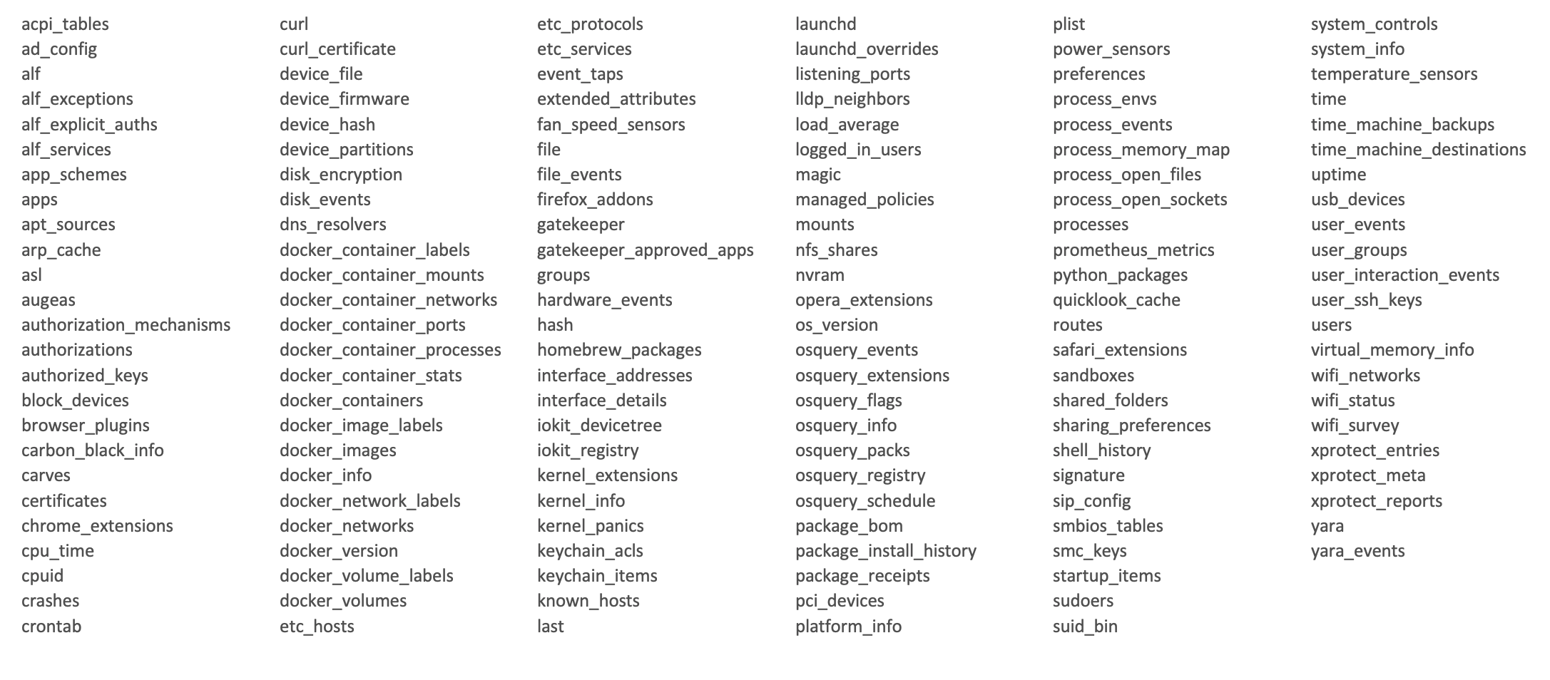
osquery tables
Notes:
This is a sample of the osquery tables that were available on my mac when I did an enumeration of them several months back. This list gets longer every month or two, as new functionality is added to osquery with new updates.
Latest version has more than 220 tables!

Slide 21
osquery: Use Cases
Standalone for live forensics / triage
Baselining: queries can be scheduled and reports compared for deviations: ie. USB device events, listening ports, scheduled tasks
Allows you to perform file integrity monitoring
Integration with YARA: scan every new file created under /Users, /Windows/Temp, etc…
Installed as a service for continuous monitoring and data collection, and used with Kolide for ad hoc queries (i.e. hunting)

Slide 22
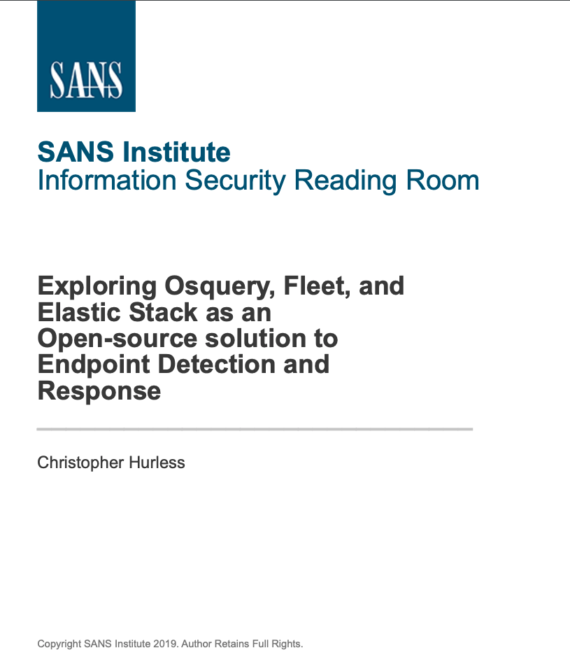
Osquery + Fleet + Elastic Stack
STI paper on SANS Reading Room
Exploring Osquery, Fleet, and Elastic Stack as an Open-source solution to Endpoint Detection and Response by Christopher Hurless –
September 10, 2019
https://www.sans.org/reading-room/whitepapers/detection/paper/39165

Slide 23
Velociraptor
https://github.com/Velocidex/velociraptor
Developed by former lead developer of GRR Rapid Response at Google Inc. (Rekall)
Velociraptor is a tool for collecting host based state information using Velocidex Query Language (VQL) queries.
It can be used for surgical collection of evidence across multiple endpoints, ie.
collect all exe’s created in a home directory in the last day,
collect Microsoft Word documents containing a keyword,
report on all chrome extensions my users have installed.
Notes:
Michael Cohen.

Slide 24
Low Level Telemetry: ETW
Event Tracing for Windows (ETW) is a hidden treasure in Microsoft Endpoints.
ETW is a tracing technology that’s been available in Windows since Windows 2000. It was originally designed to help Microsoft engineers debug the operating system – for example, performance measurements, and power management tracing.
Requires custom development efforts!
ETW provides visibility into most core Windows subsystems, including:
Network activity
Process creation/termination
Thread creation/termination
Memory allocation
DLL load/unload
PowerShell method invocation
DNS resolutions (cached and hot)
Firewall activity
WMI activity
WinINet request/response headers
and so much more…
In Windows 10, there's more than 1000 providers.
Notes:
ETW, first introduced in Windows 2000, is a lightweight Kernel level tracing facility that was originally intended for debugging, diagnostics and performance.
To consume events from an ETW provider, the consumer needs to first create a trace session. Each trace session can consume one or more providers.

Slide 25
ETW: Drinking From A Fire Hose
https://blogs.technet.microsoft.com/office365security/hidden-treasure-intrusion-detection-with-etw-part-1/
Imagine trying to send this data to your SIEM:
every DLL load in every process
every thread creation in every process
every process start on every endpoint
To use of this new data source, we’ll need some way to filter and/or aggregate the data

Slide 26
ETW: Because Free Telemetry is …Free!
https://github.com/fireeye/SilkETW
SilkETW & SilkService are flexible C# wrappers for ETW, they are meant to abstract away the complexities of ETW and give people a simple interface to perform research and introspection.
SilkETW: Because Free Telemetry is … Free! - here
SilkETW & SilkService BlackHat Arsenal 2019 - here
Threat Hunting with ETW events and HELK — Part 1: Installing SilkETW (by @Cyb3rWard0g) - here
Threat Hunting with ETW events and HELK — Part 2: Shipping ETW events to HELK (by @Cyb3rWard0g) - here

Slide 27
New Trend: EDR based Vulnerability Management
How do you scan in IPv6 networks?
How about BYOD? Remote workers? Zero trust?
Vulnerability reports work right? – yeah... sure…

Slide 28
Endpoint Security Needs: Detection
Good solid detection starts with solid visibility and data collection.
On top of that EDR tools provide:
Continuous monitoring and recording of endpoint system level behaviors
Data analytics techniques to detect suspicious behavior
Contextual information
Ability to triage faster, and pivoting across different sources
Some may provide blocking with EPP integration
Some may provide additional integration with SIEM, Sandbox, DLP, Gateway, Cloud and other sources
And of course, response and remediation!
Notes:
Some interesting consequences of this… ENTERPRISE vs ENDPOINT.
EPP traditionally managed by IT, now managed by SECOPS. Remediation was traditionally an IT function… now what??

Slide 29
Endpoint Security Needs: Behaviors
https://attackevals.mitre.org/
MITRE evaluates cybersecurity products using an open methodology based on our ATT&CK™ framework. Our goals are to:
Empower end-users with objective insights into how to use specific commercial security products to detect known adversary behaviors
Provide transparency around the true capabilities of security products and services to detect known adversary behaviors
Drive the security vendor community to enhance their capability to detect known adversary behaviors.
These evaluations are not a competitive analysis. There are no scores, rankings, or ratings. Instead, we show how each vendor approaches threat detection in the context of the ATT&CK matrix.

Slide 30
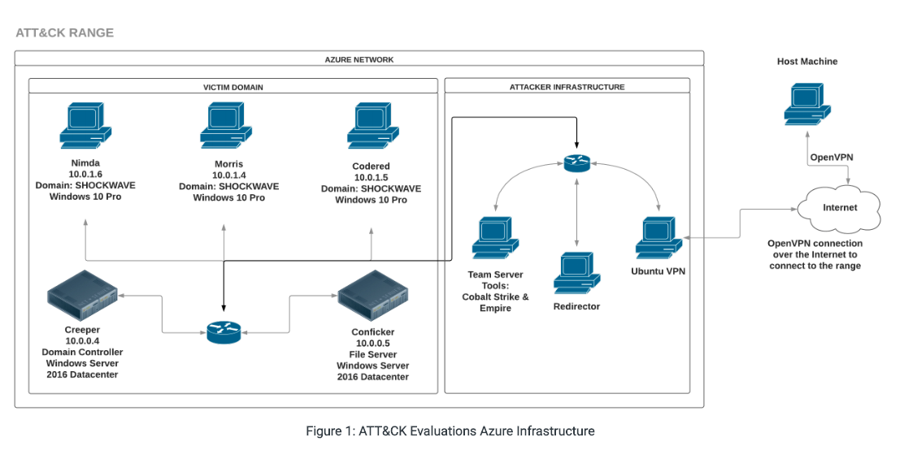
MITRE evaluations methodology: APT3
https://attackevals.mitre.org/methodology/round1/
MITRE’s evaluation methodology is publicly available, and all evaluation results are publicly released.
Round 2, APT29 emulation results, will be published in the near future. More details here https://attackevals.mitre.org/methodology/round2/

Slide 31
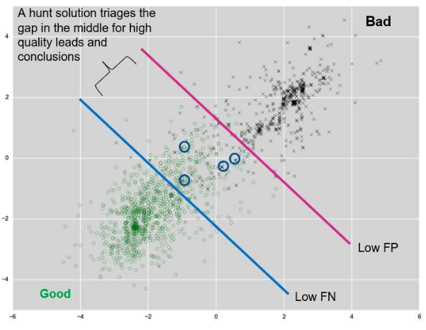
Endpoint Security Needs: Hunt - Bring on the False Negatives!
Detecting or doing triage is not threat hunting!!
Most prevention and detection oriented tools make poor threat hunting solutions.
Prevention and real-time detection are focused on low FPs
Hunting solutions should be optimized for low FNs

Slide 32
Endpoint Security Needs: Act
EDR should let you:
Contain system
Shutdown system
Dump process / memory
Terminate running process
Uninstall services
Log off user
Delete file or directory
Run custom script X
….
https://www.sans.org/webcasts/traditional-edr-working-and-about-109920

Slide 33
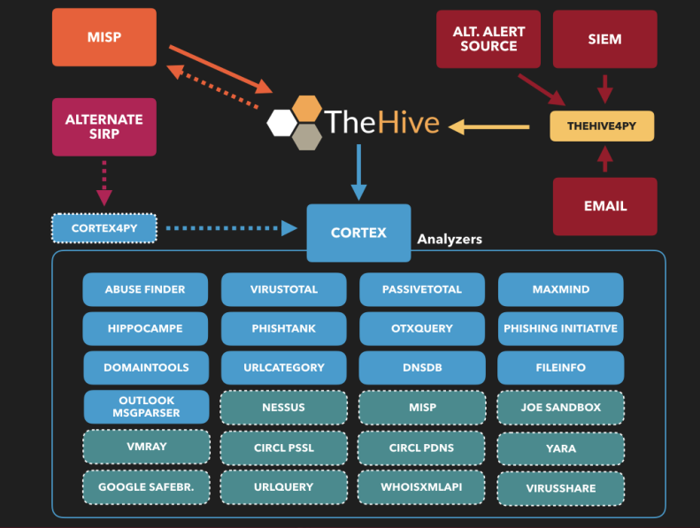
Act: Integration with SOAR platforms
TheHive / Cortex Stack
TheHive is a Security Incident Response Platform (SIRP). It can receive alerts from different sources (SIEM, IDS, email. etc.) via its REST API.
alert feeder as a specialized program which consumes a security event (SIEM alert, email report, IDS alert, and so on), parses it and outputs an alert that its sends to TheHive through TheHive4py
Cortex is the perfect companion of TheHive, comprised of analyzers that you can run against observables.

Slide 34
Conclusions
Prevention has its place and will continue to have it, but when architecting for endpoint security, focus on shortening detection and response – P > D+R
Use the IR hierarchy of needs to drive your requirements
Start with the basics: solid D+R starts with solid inventory and telemetry
Leverage Open Source & Free solutions to understand capabilities and create use cases
Focus on behaviors and don’t forget that response is key

Slide 35


Presentation based on SEC530: Defensible Security Architecture and Engineering
Thank you!! @aboutsecurity @SecurityMapper
References
https://www.sans.org/course/defensible-security-architecture-and-engineering
Notes:
JUSTIN & I we’re committed to make the BLUE TEAM community awesome.
There’s a lot more we could talk about... Check out SEC530.
But we are also willing to help to guide you if you have any ideas to make the blue team community better, through tools, etc…

